Slide 1


Supporting Communities with Retrofit
Emily Thompson
Fuel Poverty & Retrofit Director
Groundwork
Emily.thompson@groundwork.org.uk

Slide 2

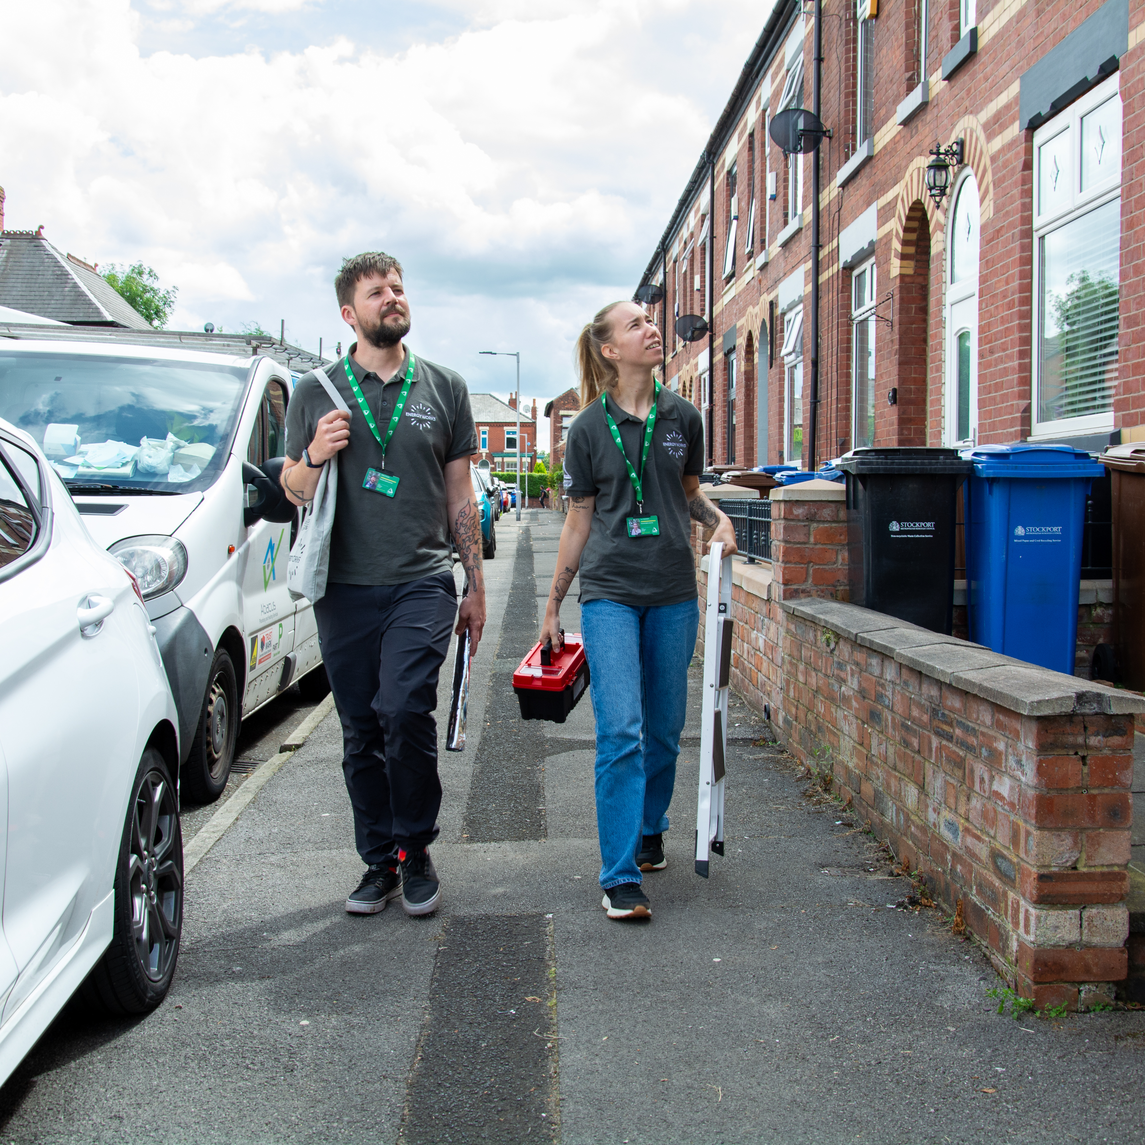
Green Doctor Energy Advice
Install small measures
In-home visits switchboard support
Signposting & wider support
Behaviour change advice
Notes:
Delivering Green Doctor for over 10 years
UK wide services
arranging in home advice appointments to identify causes of heat loss
Behavioural change advice, in particular prevention of damp, mould and condensation
offering useful tips for saving energy and water, and support switching energy providers to save money
help with access to other support, such as emergency heating, government subsidies and grants, advice on energy or water debt.
Fitting energy-saving measures. As a part of our in-home visits, Green Doctors are equipped to fit small energy-saving measures such as draught excluders and radiator panels.

Slide 3

Resident focused Retrofit
Groundwork offer full PAS2035 compliance
Focus on improving the living conditions for the person
Make sure the resident understands the process and feels supported
Access to funding/finance for able to pay clients
Site visits and technical monitoring for PAS and none PAS work
Trusted provider in the sector providing an impartial view on what is needed

Slide 4
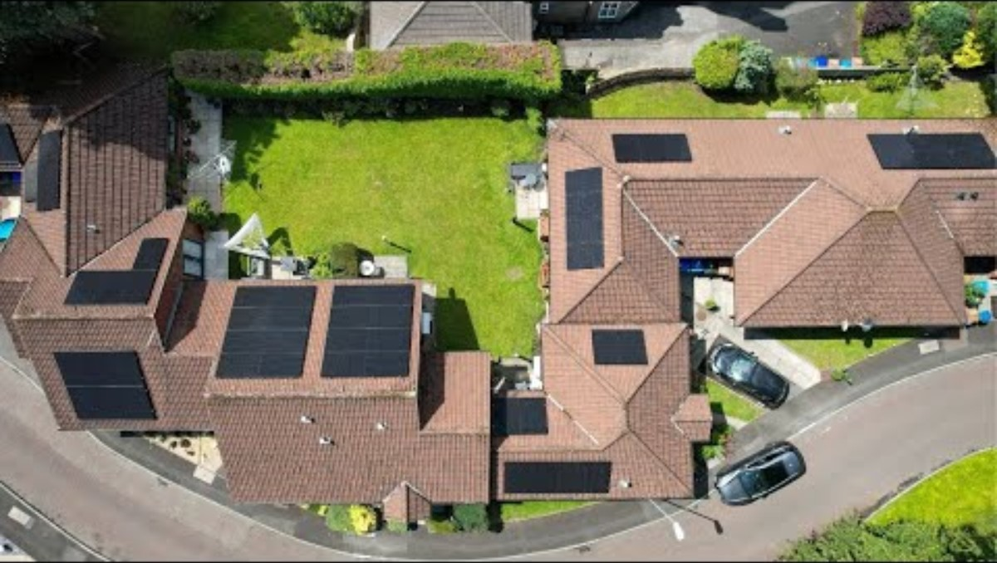
Notes:
Delivering Green Doctor for over 10 years
UK wide services
arranging in home advice appointments to identify causes of heat loss
Behavioural change advice, in particular prevention of damp, mould and condensation
offering useful tips for saving energy and water, and support switching energy providers to save money
help with access to other support, such as emergency heating, government subsidies and grants, advice on energy or water debt.
Fitting energy-saving measures. As a part of our in-home visits, Green Doctors are equipped to fit small energy-saving measures such as draught excluders and radiator panels.

